Slide 1
Wind Speed Estimation On An Embedded System Using Closely Spaced Microphones
BMI/CEN 598 (Embedded Machine Learning) Project
Sarwan Shah
Instructor: Hassan Ghasemzadeh
Lab: Embedded Machine Intelligence Lab (EMIL) Web: https://ghasemzadeh.com

Slide 2
Motivation
Wind is one of the most important meteorological parameters that is used in forecasting weather. Today, most of our wind data is gathered using anemometers installed on AWSs (Automatic Weather Stations).
This data is critical for accurately predicting short-term & long-term weather phenomena, extreme weather events, and understanding microclimates. The need for which has increased following Climate Change.
Despite modern technological advances, we find ourselves limited in the density of meteorological data we have today, and hence, struggle predicting weather at a higher/finer spatial and temporal resolution.
Estimating windspeed using closely-spaced microphones on an embedded system could lead to advances where such devices could be deployed at scale and at a low cost.
Furthering research into this area could allow us to smartly incorporate this approach in devices of everyday use, such smartphones or let’s say cars.

Slide 3
Proposed Solution
The idea behind this project stems from the paper [1], which explores a data-driven approach towards estimating the wind speed and direction based on the correlation/or spatial coherence of wind noise signals between closely-spaced microphones.
Our Solution:
Primarily, we want to study and explore the feasibility and challenges around deploying such a model on an embedded system. (First Objective)
Furthermore, we know that microphones can be sensitive to changes in temperature and humidity. If such an approach is to incorporated in a weather instrumentation device, then it needs to be temperature and humidity invariant. To address this, we will increase the dimensionality of the problem and incorporate temperature and humidity as features to our model to get an invariant prediction. (Second Objective)
[1] D. Mirabilii, K. K. Lakshminarayana, W. Mack and E. A. P. Habets, "Data-Driven Wind Speed Estimation Using Multiple Microphones," ICASSP 2020 - 2020 IEEE International Conference on Acoustics, Speech and Signal Processing (ICASSP), Barcelona, Spain, 2020, pp. 576-580, doi: 10.1109/ICASSP40776.2020.9054381.

Slide 4
Data Collection
The ESP 32 was utilized as the processing unit for this challenge due to its high memory capacity and processing speed. Sampling simultaneously across 4 devices.
Two dedicated I2S peripherals for audio processing.
Two INMP441 MEMs microphones were used due to their high sensitivity and were coupled on a shared line using the left and right channels. Intention was to use at-least 3, but limitations with I2S.
Data from the two channels was sampled at 1 kHz and 16-bits.
A hall effect anemometer was used as the control for generating labels. Additionally, temperature and humidity were also recorded using a DHT11 sensor.
A total of 5000+ samples were gathered using a fan with 10 variable speeds.
Care was taken to ensure that the speed was varied with equal variance across the 10 available setting
Data was gathered in-accordance with direction – hopes to use it for classification task
Direction | North | North East | East | South]East | South | SouthWest | West | North West
~ # Samples | 2000 | 600 | 600 | 600 | 600 | 600 | 600 | 600

Slide 5
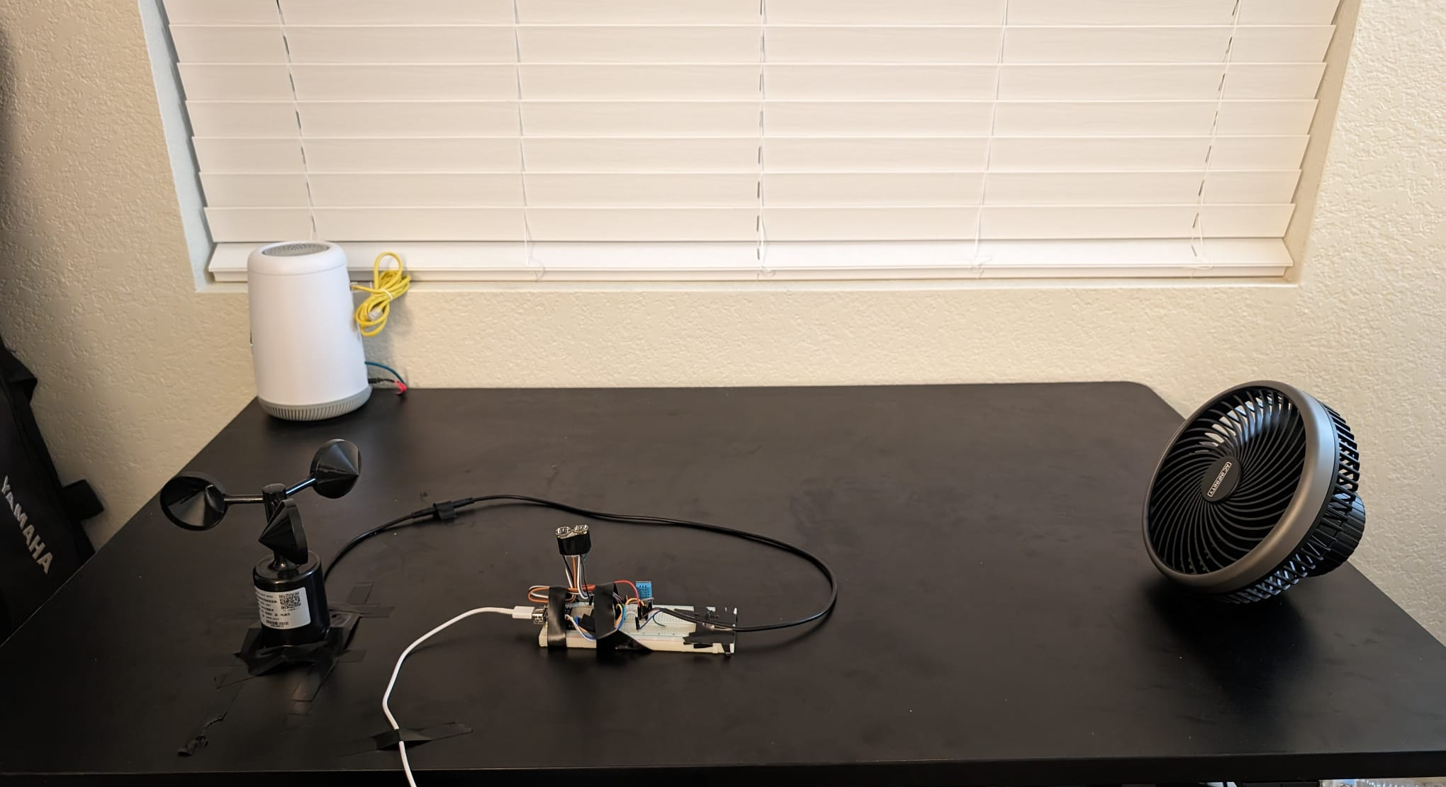
Data Collection

Slide 6
Data Collection
The ESP 32 was utilized as the processing unit for this challenge due to its high memory capacity and processing speed. Sampling simultaneously across 4 devices.
Two dedicated I2S peripherals for audio processing.
Two INMP441 MEMs microphones were used due to their high sensitivity and were coupled on a shared line using the left and right channels. Intention was to use at-least 3, but limitations with I2S.
Data from the two channels was sampled at 1 kHz and 16-bits.
A hall effect anemometer was used as the control for generating labels. Additionally, temperature and humidity were also recorded using a DHT11 sensor.
A total of 5000+ samples were gathered using a fan with 10 variable speeds.
Care was taken to ensure that the speed was varied with equal variance across the 10 available setting
Data was gathered in-accordance with direction – hopes to use it for classification task
Direction | North | North East | East | South]East | South | SouthWest | West | North West
~ # Samples | 2000 | 600 | 600 | 600 | 600 | 600 | 600 | 600

Slide 7
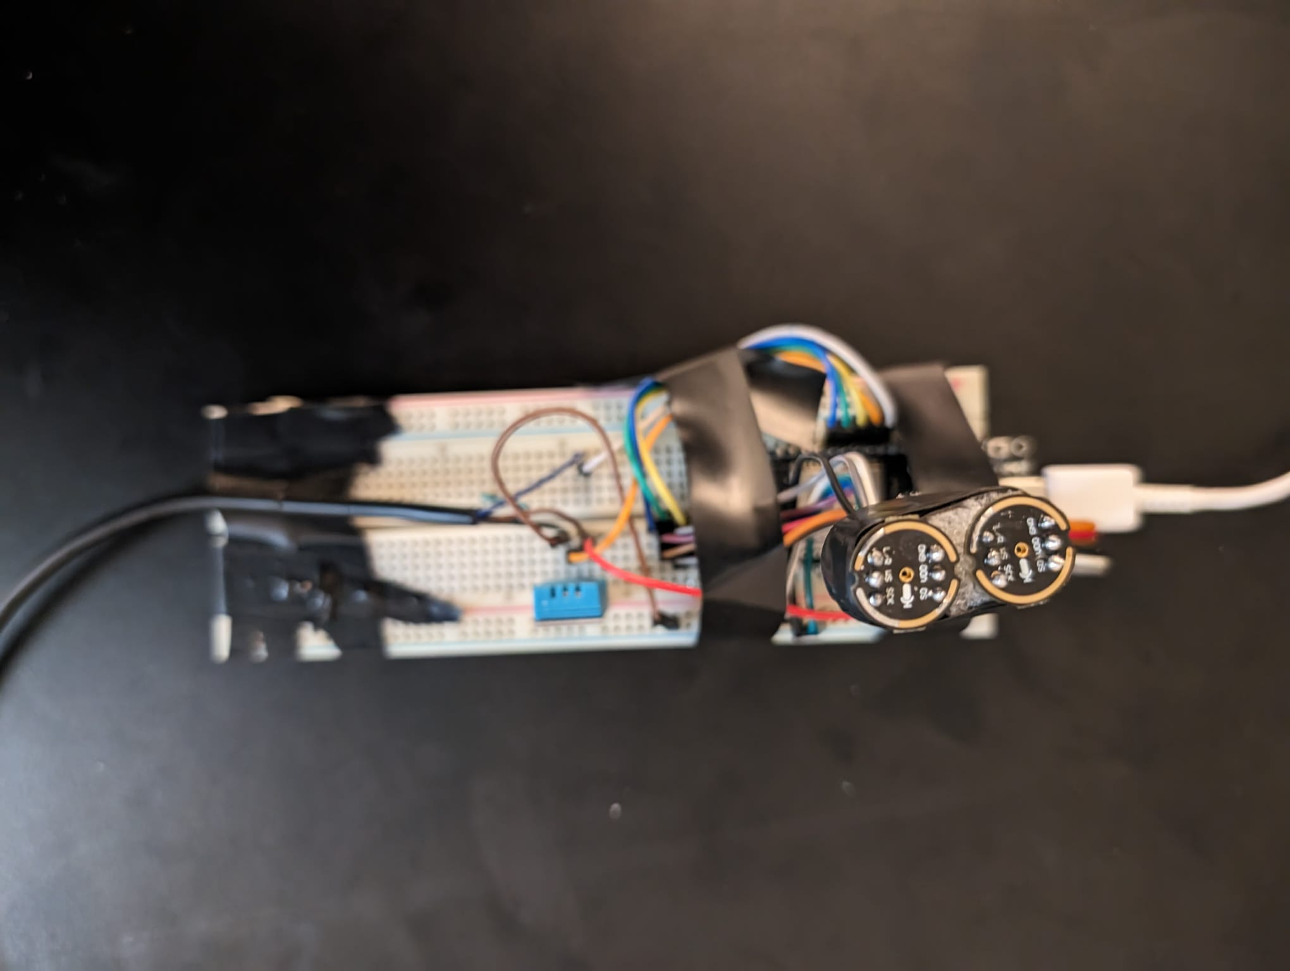
Data Collection

Slide 8
Data Collection
The ESP 32 was utilized as the processing unit for this challenge due to its high memory capacity and processing speed. Sampling simultaneously across 4 devices.
Two dedicated I2S peripherals for audio processing.
Two INMP441 MEMs microphones were used due to their high sensitivity and were coupled on a shared line using the left and right channels. Intention was to use at-least 3, but limitations with I2S.
Data from the two channels was sampled at 1 kHz and 16-bits.
A hall effect anemometer was used as the control for generating labels. Additionally, temperature and humidity were also recorded using a DHT11 sensor.
A total of 5000+ samples were gathered using a fan with 10 variable speeds.
Care was taken to ensure that the speed was varied with equal variance across the 10 available setting
Data was gathered in-accordance with direction – hopes to use it for classification task
Direction | North | North East | East | South]East | South | SouthWest | West | North West
~ # Samples | 2000 | 600 | 600 | 600 | 600 | 600 | 600 | 600

Slide 9
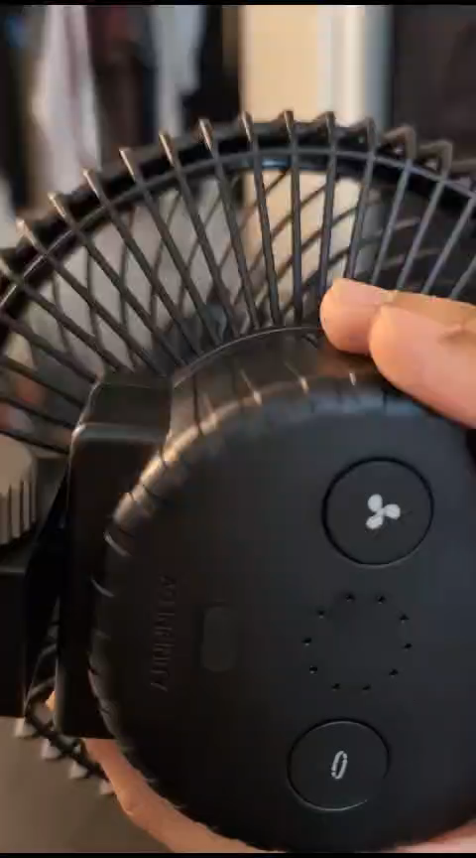
Data Collection

Slide 10
Training Process
The data was normalized using min-max standardization
Spectrograms were created separately for the data of each microphone for each of the 1 second sample. The frequency of spectrograms was limited to 51 Hz.
A convolutional neural network was trained with the two spectrograms of the microphones as an input and the wind speed of the control as a target.

Slide 11
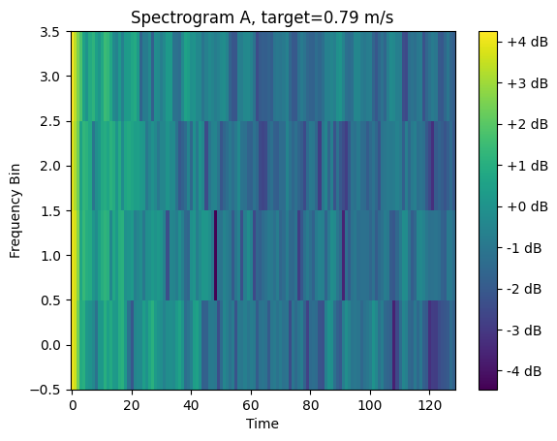

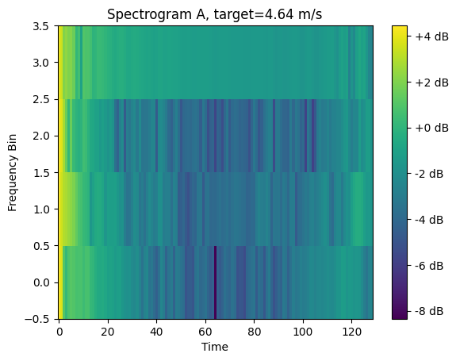
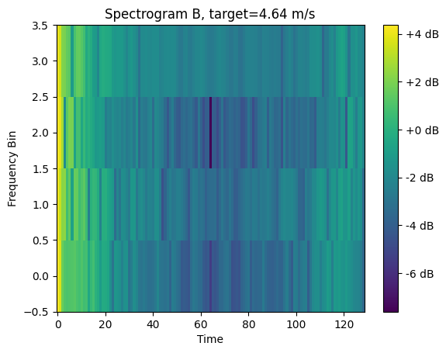
Training Process

Slide 12
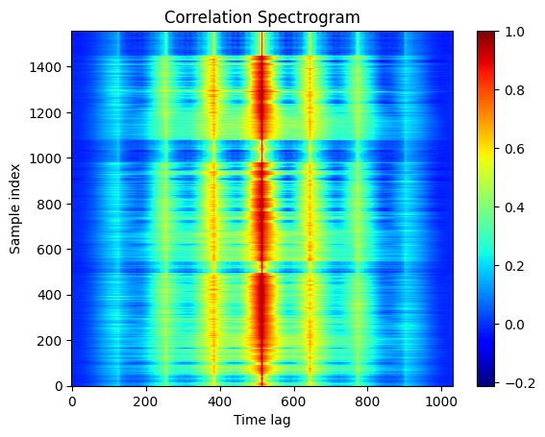
Training Process
Correlation Between Spectrogram's

Slide 13
Training Process
The data was normalized using min-max standardization
Spectrograms were created separately for the data of each microphone for each of the 1 second sample. The frequency of spectrograms was limited to below 51 Hz.
A convolutional neural network was trained with the two spectrograms of the microphones as an input and the wind speed of the control as a target.
Generally, for now, over-fitting was observed on the training data.
This could be attributed to either the model not being complex enough to capture the true relation.
Or that more feature engineering is required to make the features in audio-data be usable by the neural network.

Slide 14
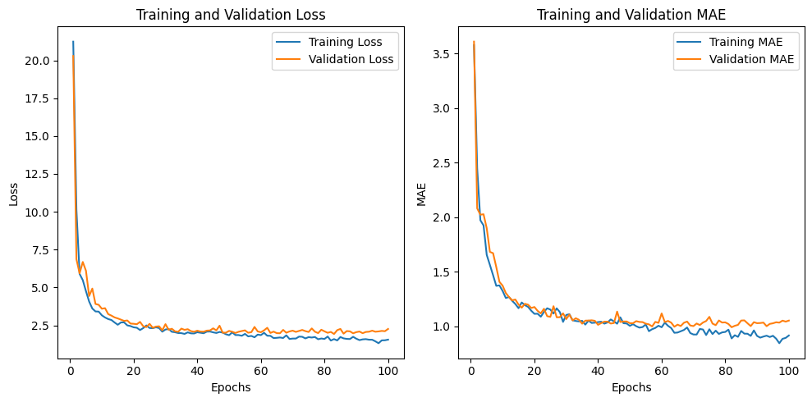
Training Process
Loss and Mean-Absolute Error Curves for Training Process

Slide 15
Overall Results
While there seems to be some evidence of features present in the spectrograms due to their closely spaced-apart position, but without further experimentation and analysis, it remains inconclusive.
Due to inconclusive results, could not run inference.
Reflections & Future Work:
Working with audio-data on embedded systems is challenging. The primary constraint after memory being the ability to sample data at a high enough rate. (There were challenges when I initially tried to sample at 8 & 16 kHz).
Constrained on time. Getting experimental setup ready and data gathering was time consuming.
Using the existing data to train a logistic regression natured model to see if the positional information about the wind can be classified
Working on feature extraction from spectrograms. Checking of their information in their correlation yields any meaningful results.

Slide 16

GO DEVILS!

